Slide 1
Advisor: Prof. Wen-Kai Tai
Student: Ze-Hao Wang

Slide 2
Agenda
Introduction
Related Works
Mission / Space framework
Map Sketches & Evolution of Segments
Proposed Methodologies
System Architecture
Mission Grammars
Room Instructions and Definitions
Genetic Algorithm in Segments Evolution
Experimental Results
Conclusions and Contributions
Future work

Slide 3
Introduction

Slide 4
Motivation

Slide 5
Research Goals

Slide 6
Related Works
Mission / Space framework

Slide 7
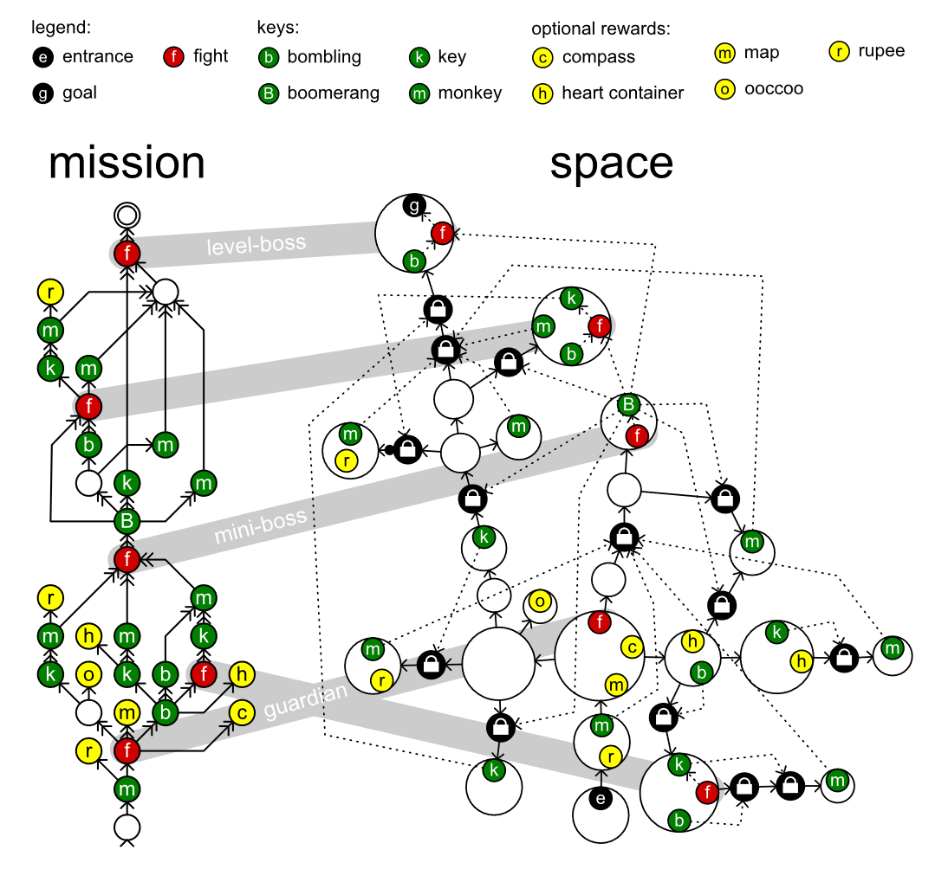
Mission / Space framework
Mission/Space framework, focuses on level design and the mechanics that control player progression through a game.
Transformational Grammars
Mission Grammars
Space Grammars
Mission Graph Convert into Space Graph

Slide 8
Transformational Grammars

Slide 9
Mission Grammars

Slide 10
Space Grammars

Slide 11
Transformational Grammars

Slide 12
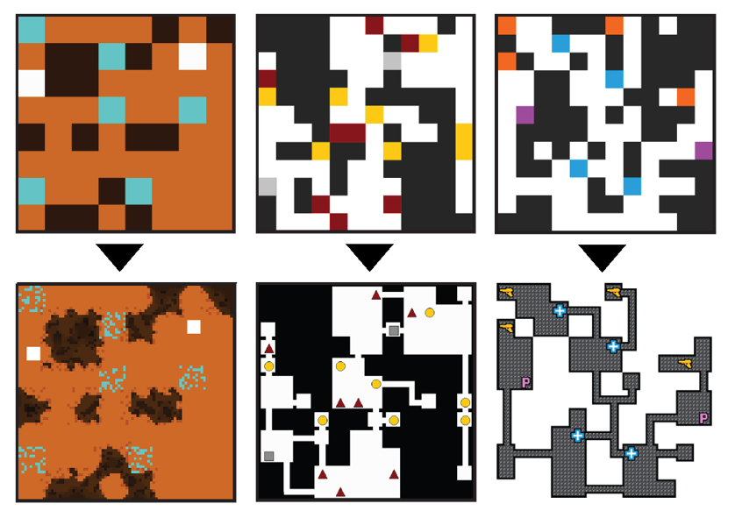
Map Sketches & Evolution of Segments
Mission/Space framework, focuses on level design and the mechanics that control player progression through a game.
Map Sketches
Map Sketch Evolution
Dungeon Segments
Dungeon Segment Evolution

Slide 13
Map Sketches

Slide 14
Map Sketch Evolution

Slide 15
Dungeon Segments

Slide 16
Dungeon Segment Evolution

Slide 17
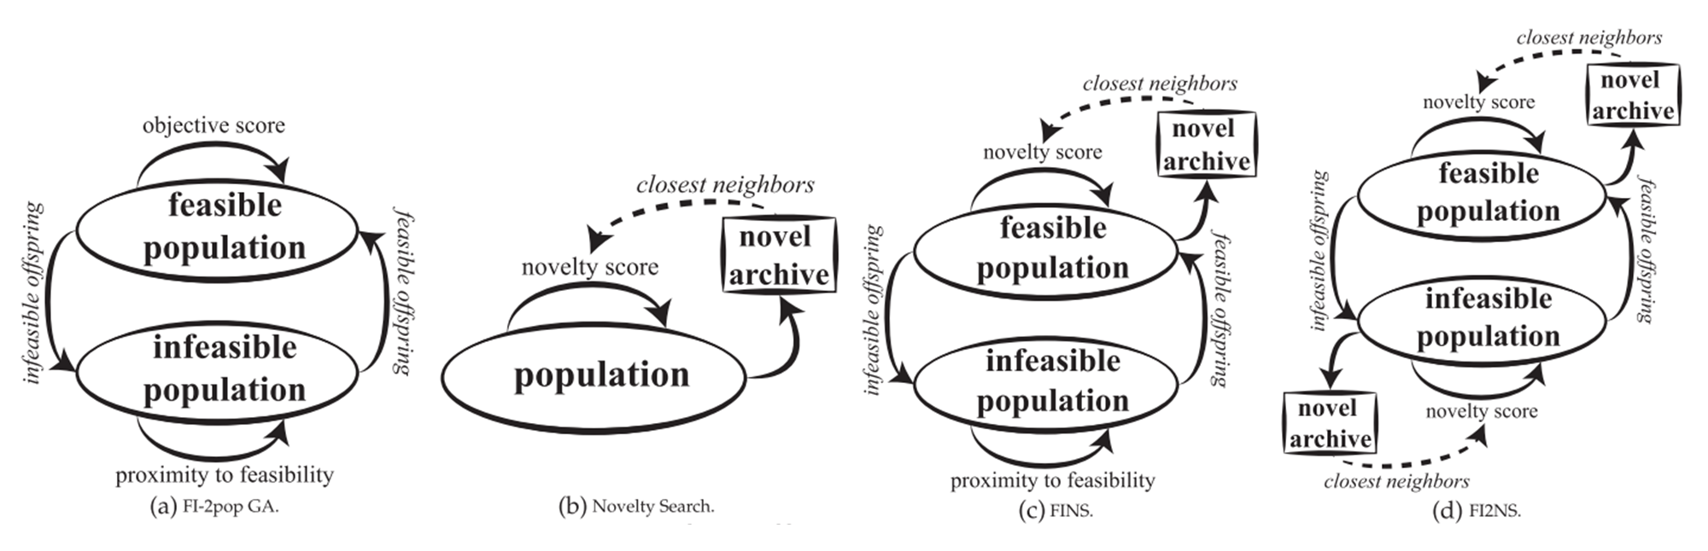
Constrained Novelty Search

Slide 18
Proposed Methodologies

Slide 19
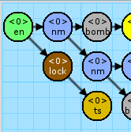


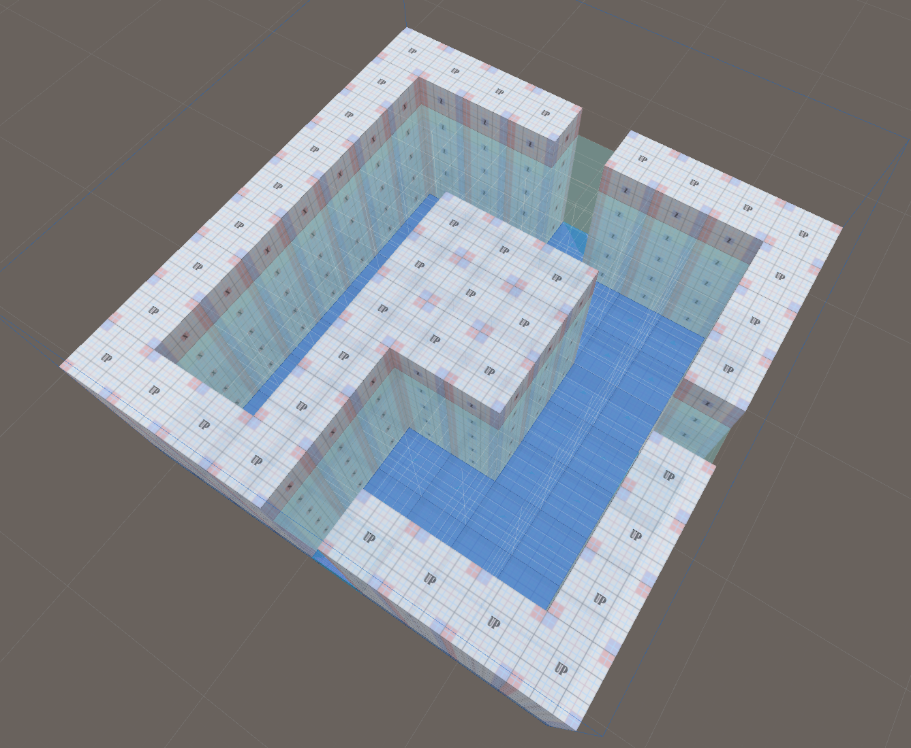
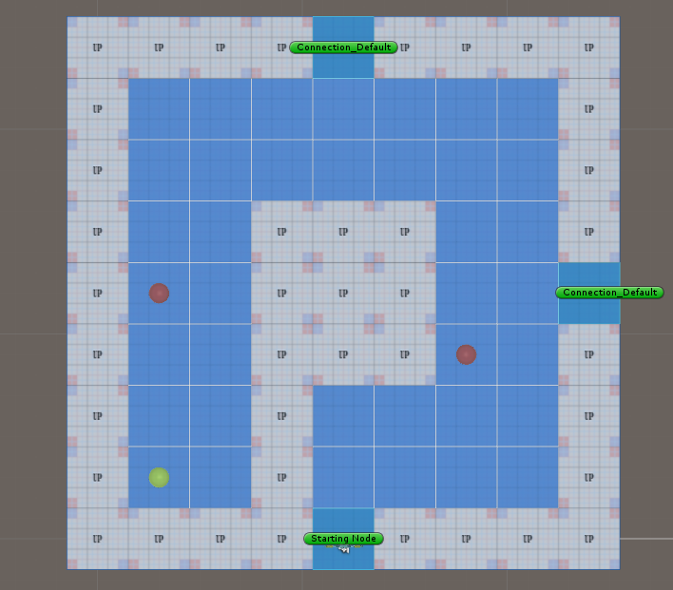
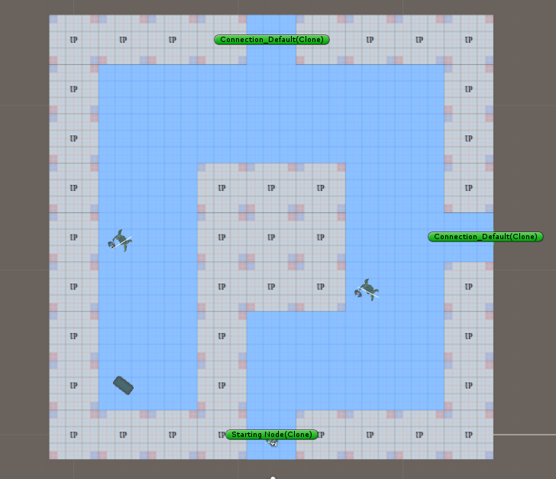
System Architecture
圖片 需更換

Slide 20
System Architecture
圖片 需更換

Slide 21
System DEMO

Slide 22
Mission Grammars

Slide 23
Room Instructions and Definitions

Slide 24
Genetic Algorithm in Segments Evolution

Slide 25
Experimental Results

Slide 27
Conclusions and Contributions

Slide 28
Conclusions

Slide 29
Contributions

Slide 30
Future Work

